Slide 1

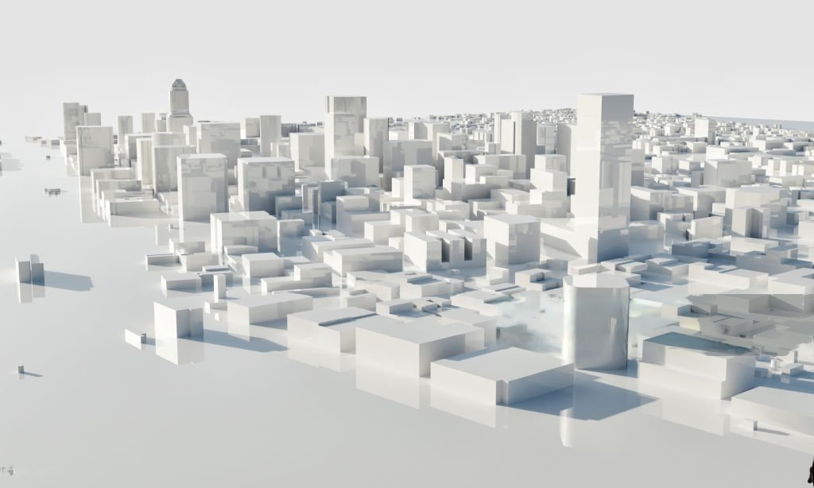
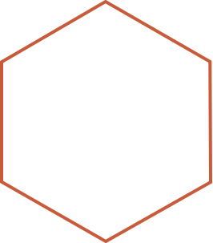
Bay Area Real Estate Unveiled: A Data-Backed Perspective

Slide 2
Who we are?
Adeel Nasir
Kranthi kumar Irala
Azmat Ahmed Shaik
Karthikeyan Velusamy
Srilekha Matam
Chandana kandula
Aparijitha Srinivasan
Dhruvish Manishbhai Chanchad

Slide 3
What’s our agenda today?
Introduction
01
Data-Source
02
Data
03
Insights from the data
04
Predictive analysis
05
3

Slide 4
Intro
01
The San Francisco Bay Area, often referred to as the 'Tech Capital of the World,’ or ‘Silicon Valley’ encompasses a diverse range of cities and communities surrounding the iconic San Francisco Bay. This region is renowned for its innovation, cultural richness, and stunning landscapes
Silicon Valley's real estate market is defined by its global tech hub status, marked by high property values driven by the strong demand from tech professionals and executives.
02

Slide 5
Cont….
The presence of major tech giants like Google and Apple in the region exerts a significant influence, creating robust demand for housing near tech campuses, affecting both home prices and rental rates
03
Silicon Valley's real estate landscape is characterized by diversity in property types, offering everything from luxurious homes in prestigious neighborhoods to ambitious urban redevelopment projects
04

Slide 6
What was our aim?

Slide 7
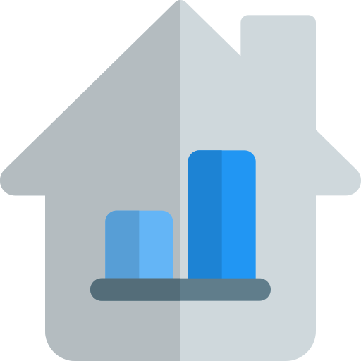
Rent Vs Sale properties comparison of various cities in bay area
Affordability Assessment
Investment Potential
ROI Calculation
Focusing on Bay Area except San Francisco
Exploring the real estate situations in the bay area except San Francisco Down Town
Excluding San Francisco gives more diversified analysis
Avoiding high impact of high priced properties
Zip Code wise real Estate analysis
Demographic situations in specific zipcode
Economic indicators of specific areas with in bay area
Hyperinflation status

Slide 8
Where did we get our data?

Slide 9

Data Source
Redfin Corporation, based in Seattle, provides residential real estate brokerage and mortgage origination services. The company operates in more than 100 markets in the United States and Canada. The company has a 0.80% market share in the United States by number of units sold and has approximately 2,000 lead agents.

Slide 10
What have we done with Redfin?
Step2
Step5
Fetching sales and rental properties using BeatifulSoup Library
Exported cleaned dataset files in csv format
Step 1
Collecting Citywise Redfin links for bay area
Step 3
Step 4
Sales and Rental data frame creation
Cleaned data by dopping some columns, filling bad values

Slide 11
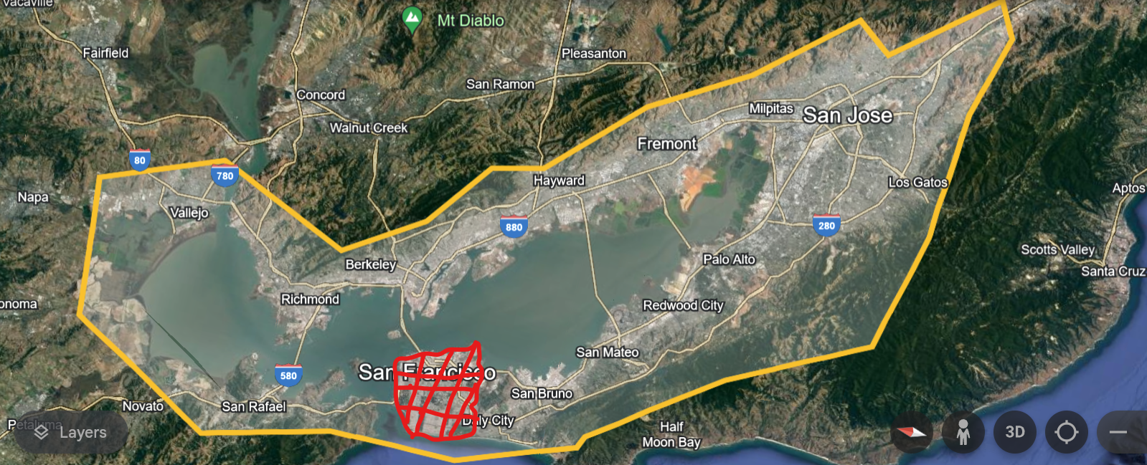
Data
Total 19 cities ( Entire Bay area except San Francisco)
Where are our data from?

Slide 12
How was our data looks like?

Slide 13
Data
We scrapped Sales and Rental properties using beautiful soup library
Raw data | Sales | Rental
# of Rows | 2404 | 1997
# of Columns | 19 | 17

Slide 14
Data
After cleaning the data our final data-source had the following size
Cleaned Data | Sales | Rental
# of Rows | 1937 | 1289
# of Columns | 17 | 10

Slide 15
Data
What Sales & Rental data have common ?
Column
Price
Beds
Baths
Area_Sqft
City
Zip

Slide 16

Data
Where both Sales & Rental data differs?
Rental
Column
Property Type
Community
Lot_Size_Sqft
EMI (est)
Price/Sqft
HOA Dues
Sales
Column
# of Parking
# of In-Unit Aminities
# of Community Aminities

Slide 17
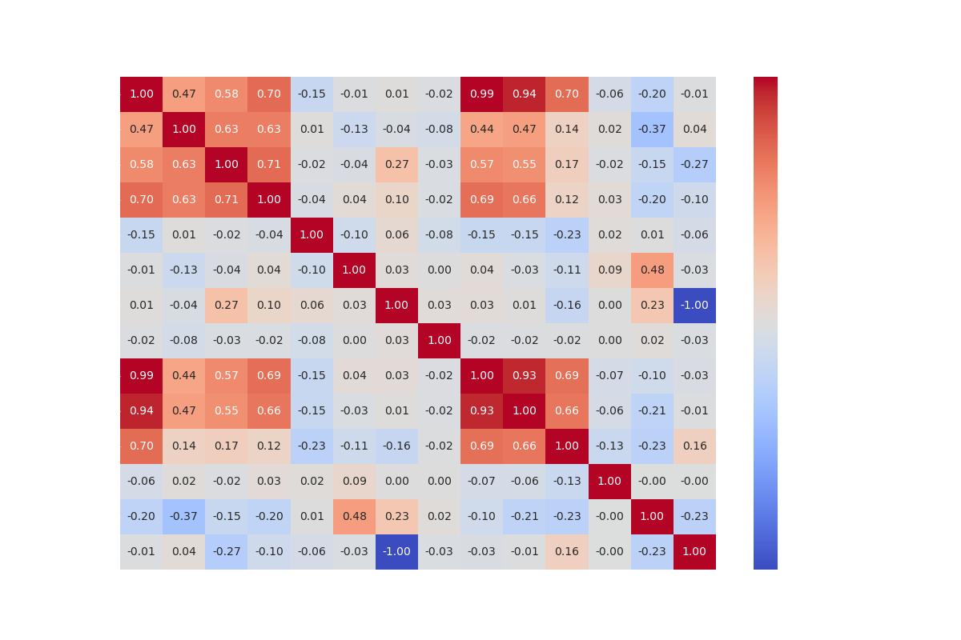
How much they dependent on each other (Sales)?

Slide 18
What we learned from the heatmap?
Older Buildings are not cheaper
Price depends on size, # of Beds, # of Baths

Slide 19
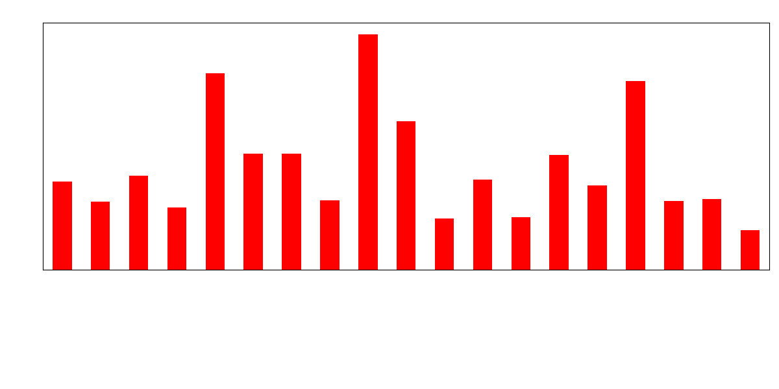
* Values in 00,000s
Average Price by City ( Sales )

Slide 20
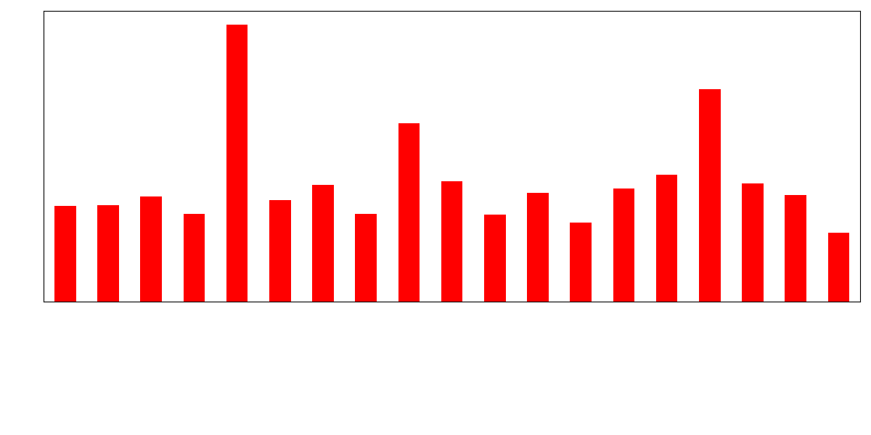
Average Price by City ( Rent )

Slide 21
What we learned ?
Costlier Cities to buy a property
Palo Alto
Sausalito
Mill Valley
Costlier Cities to rent a property
Mill Valley
Sausalito
Palo Alto

Slide 22
Where will you buy your property for renting out purpose ( based on Costlier options)?

Slide 23
Yes, Mill Valley should be your choice…. The ROI is higher compared to other two cities

Slide 24
What we learned ?
Cheapest Cities to buy a property
Vallejo
Richmond
San leandro
Cheapest Cities to rent a property
Vallejo
San Leandro
Richmond

Slide 25
Which Place you should avoid to buy a property( based on Cheapest options) ?

Slide 26
Yes, San Leandro should be avoided…. The ROI is higher compared to other two cities

Slide 27
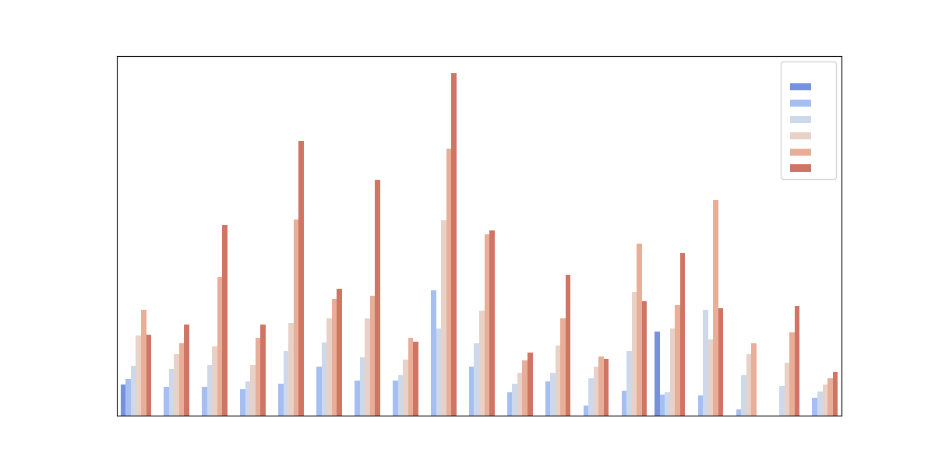
Another Price vs City with # of beds ( Sales)..

Slide 28
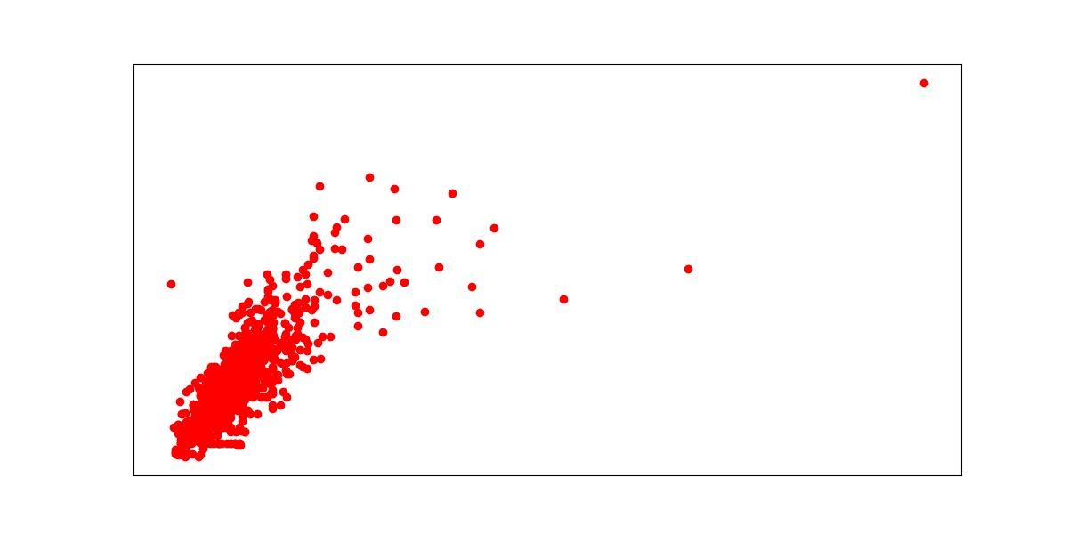
Area Size matters ( Rental) …..

Slide 29
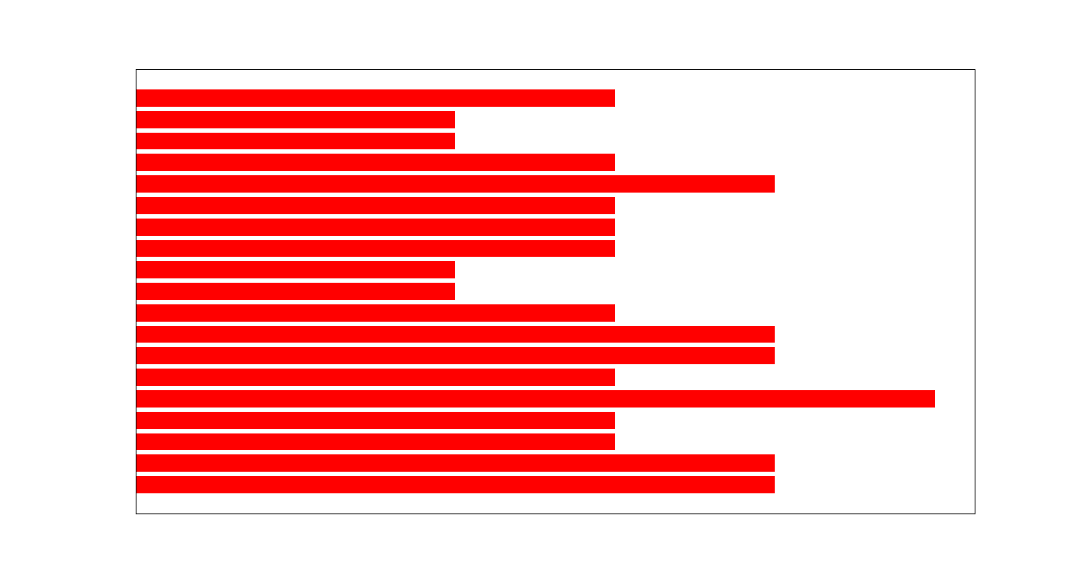
How much you need to negotiate per city (Sales)...

Slide 30
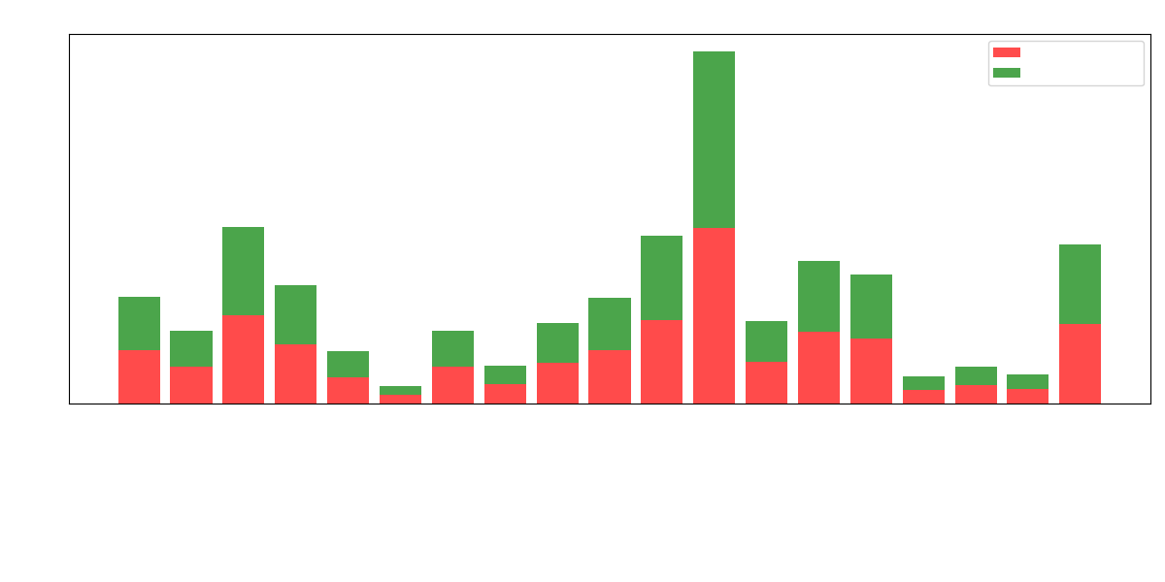
How many are there (Count)……

Slide 31
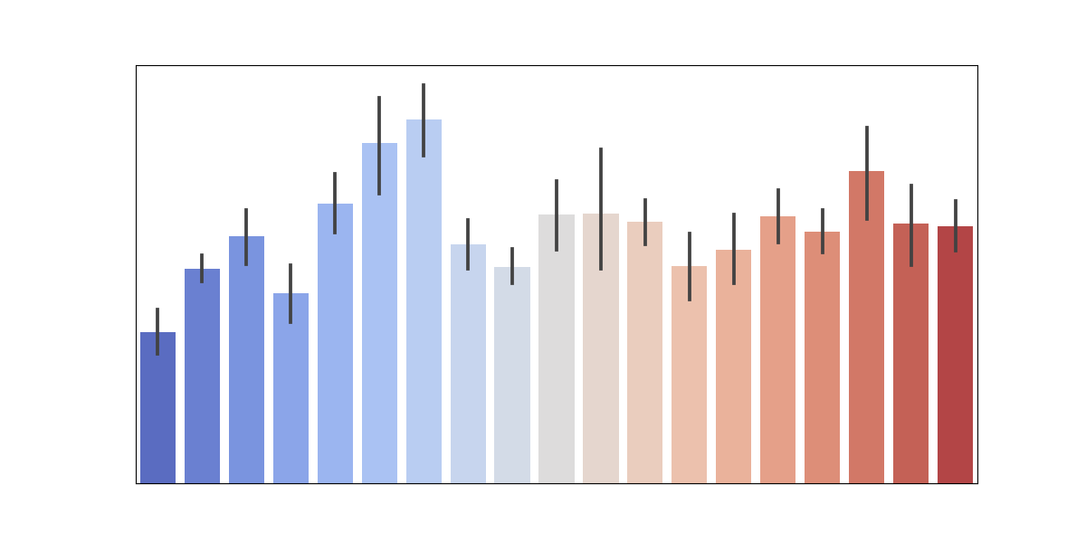
How much old they are.…

Slide 32
Top 10 Costlier zip codes in bay area( Sales)
City | ZipCode | Price
Mill Valley | 94920 | 7477000.0
Mountain View | 94022 | 6998000.0
Palo Alto | 94022 | 6998000.0
San Jose | 95014 | 3924000.0
Palo Alto | 95140 | 3899000.0
Palo Alto | 94028 | 3822500.0
Palo Alto | 94303 | 3673000.0
San Mateo | 94301 | 3547500.0
Mill Valley | 94010 | 3200000.0

Slide 33
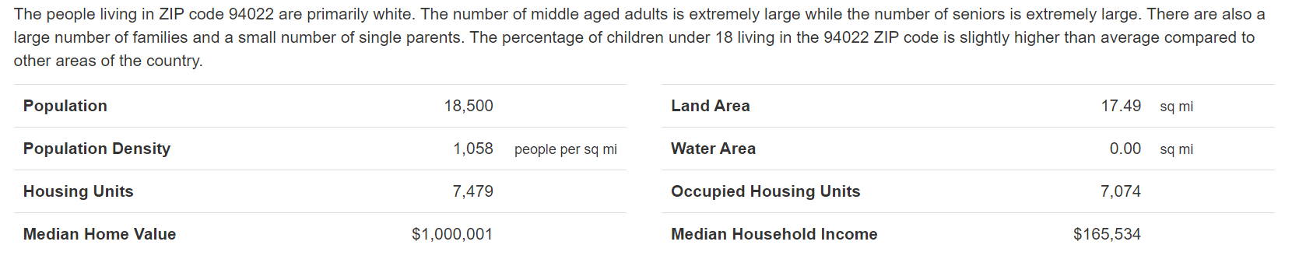
What demographics says….
Mountain View | 94022

Slide 34
Top 10 Cheapest zip codes in bay area( Sales)
City | ZipCode | Price
San Jose | 95037 | 279000.0
Fremont | 94587 | 300000.0
San Jose | 95134 | 305000.0
Oakland | 94603 | 349000.0
Fremont | 95035 | 414950.0
Vallejo | 94589 | 475000.0
Hayward | 94546 | 479950.0
San Rafael | 94903 | 499000.0
Oakland | 94619 | 499000.0

Slide 35
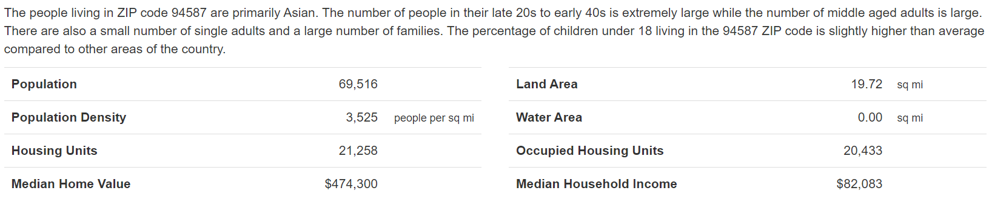
What demographics says….
Fremont | 94587

Slide 36

Summary
36

Slide 37




Thank you

